Slide 1
Data Warehouse ——From Data Warehousing to Data Mining——
徐华
清华大学 计算机系 智能技术与系统国家重点实验室
xuhua@tsinghua.edu.cn

Slide 2
Data Warehouse
Review the basic concepts of database
What is a data warehouse?
A multi-dimensional data model
Data warehouse architecture
Data warehouse implementation
From data warehousing to data mining

Slide 3
Data Warehouse Usage
Three kinds of data warehouse applications
Information processing
supports querying, basic statistical analysis, and reporting using crosstabs, tables, charts and graphs
Analytical processing
multidimensional analysis of data warehouse data
supports basic OLAP operations, slice-dice, drilling, pivoting
Data mining
knowledge discovery from hidden patterns
supports associations, constructing analytical models, performing classification and prediction, and presenting the mining results using visualization tools.
Differences among the three tasks

Slide 4
From On-Line Analytical Processing to On-Line Analytical Mining (OLAM)
Why online analytical mining?
High quality of data in data warehouses
DW contains integrated, consistent, cleaned data
Available information processing structure surrounding data warehouses
ODBC, OLEDB, Web accessing, service facilities, reporting and OLAP tools
OLAP-based exploratory data analysis
mining with drilling, dicing, pivoting, etc.
On-line selection of data mining functions
integration and swapping of multiple mining functions, algorithms, and tasks.
Architecture of OLAM

Slide 5
An OLAM Architecture
Mining query
Mining result
Layer4
User Interface
User GUI API
OLAM
Engine
OLAP
Engine
Layer3
OLAP/OLAM
Data Cube API
Layer2
MDDB
MDDB
Meta Data
Filtering&Integration
Database API
Filtering
Layer1
Data Repository
Data cleaning
Data
Warehouse
Databases
Data integration

Slide 6
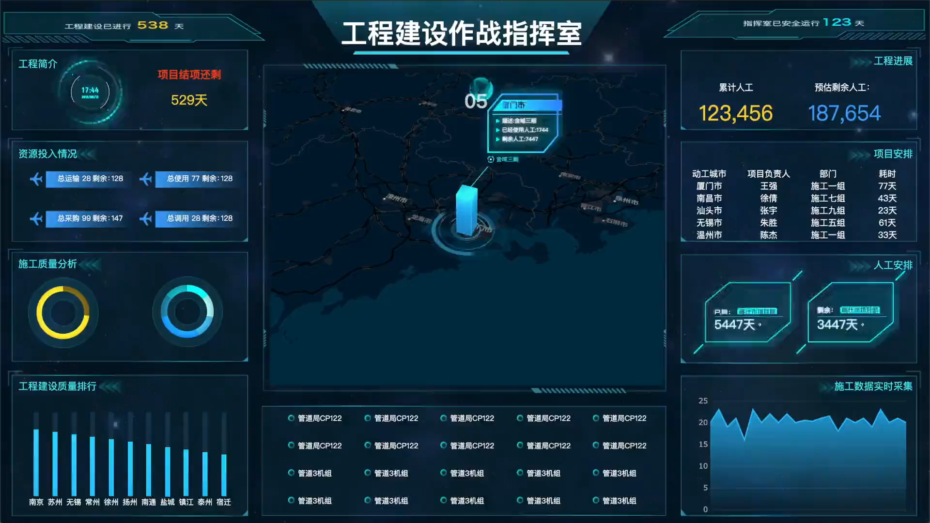
An OLAM Architecture

Slide 7
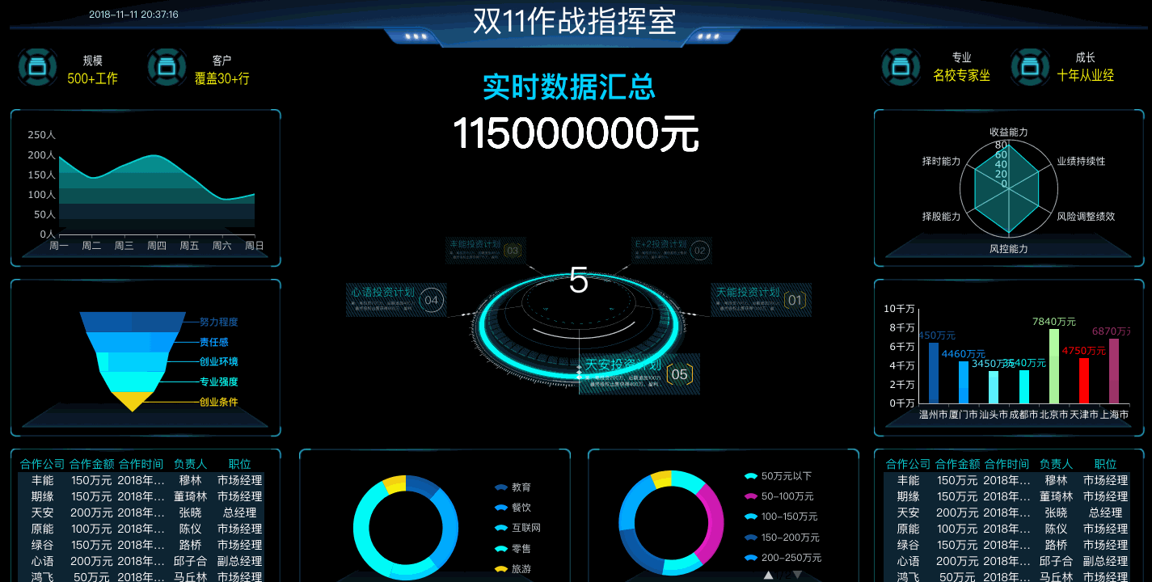
An OLAM Architecture

Slide 8
Thanks！
Notes:
工作新意图发现

